Slide 1
Ensemble Learning:
Bagging, Boosting, and Stacking
EC503 Final Project
Sijie Xiang, Minghe Ren, Xinqiao Wei
Notes:
‹#›

Slide 2
Outline
Ensemble Learning
*
Introduction of Ensemble Learning
Dataset
Three Ensemble Algorithms
Bagging
Boosting
Stacking
Comparison and Conclusion
‹#›
Notes:
‹#›

Slide 3
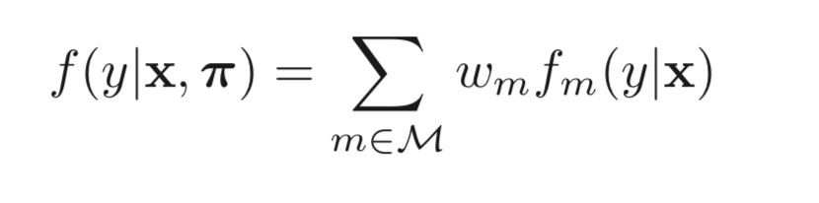
Introduction
Ensemble Learning
*
Ensemble learning (supervised machine learning)
Using multiple machine learning methods (as base learner)
The final predictor can be represented as:
Goal:
Exploring ensemble learning algorithms
Studying ensemble algorithms’ characteristics
Compare ensemble algorithms’ performance against single learners.
‹#›
Notes:
‹#›

Slide 4
Introduction
Ensemble Learning
*
Three ensemble learning algorithms:
Bagging
Boosting (Adaboost)
Stacking
Base learners:
Discriminant Analysis
Decision Tree
SVM
Comparing results:
Implementation from scratch
Matlab Built-in function
Single base learner
‹#›
Notes:
‹#›

Slide 5
DataSet
Ensemble Learning
*
Adult DataSet - Binary Classification
14 features - age, education, occupation, relationship, and etc..
Classifications - salary
>= 50k
< 50k
32561 training samples
Ecoli Dataset - Multi-Class Classification
To predict protein localization sites
336 samples
8 features and 8 classes.
‹#›
Notes:
‹#›

Slide 6
1.Bagging
Ensemble Learning
*
Ensemble Algorithms
Bagging (stands for Bootstrap Aggregating)
SVM: One-versus-one (OVO) muticlassfication for Ecoli dataset
function [test_set_predicted_Y] = Ensemble_bagging(train_set_X, train_set_Y, test_set_X, n_prime_percent, class_total)
‹#›
Notes:
‹#›

Slide 7
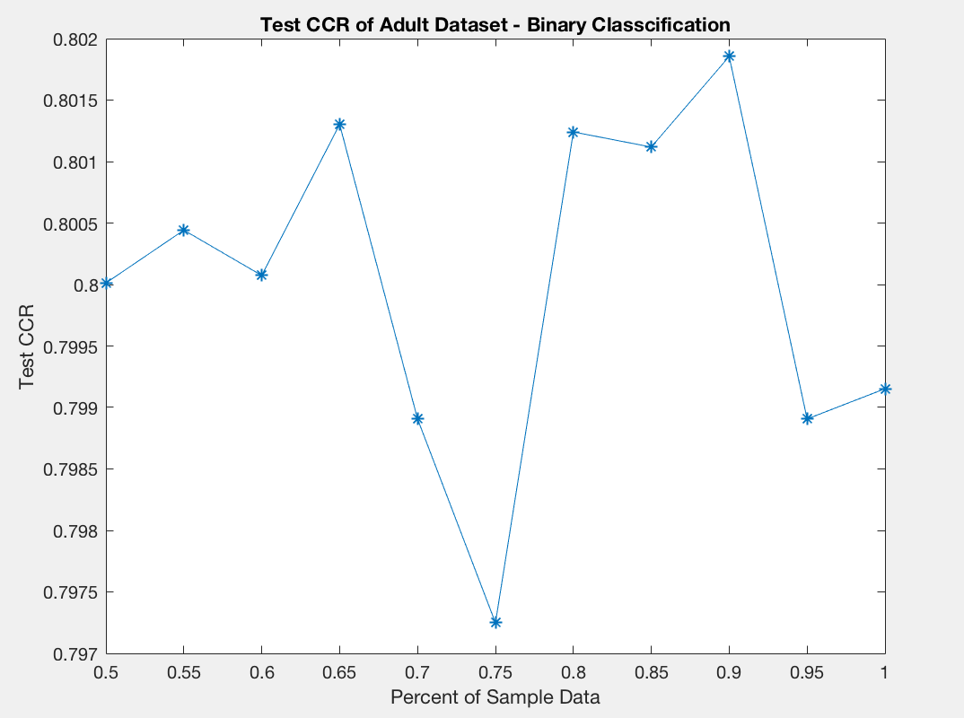
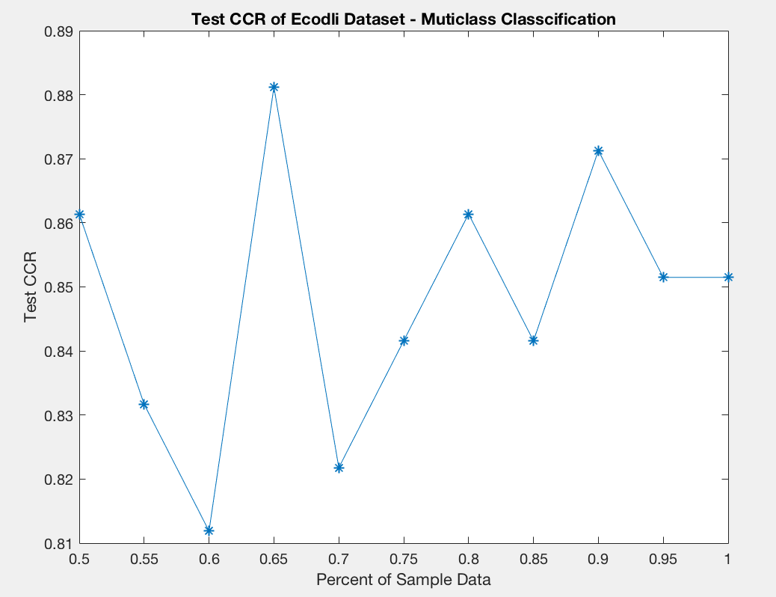
1.Bagging
Ensemble Learning
*
‹#›
Notes:
‹#›

Slide 8
1.Bagging
Insights:
Ensemble Learning
*
By increasing the size of the training set I can't improve the model predictive force
But it decreases the variance, narrowly tuning the prediction to expected outcome.
‹#›
Notes:
‹#›

Slide 9

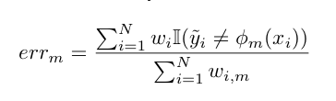


2. Adaboosting
Ensemble Learning
*
Training set
Training
Classifier
Testing
Error rate
--->
Classifier Weights
--->
Updating Samples
Weights
Final Results
Randomly choose sample
with updated weights
train_set = datasample(sample,size(sample,1),'Replace',true,'Weights',W);
‹#›
Notes:
‹#›

Slide 10
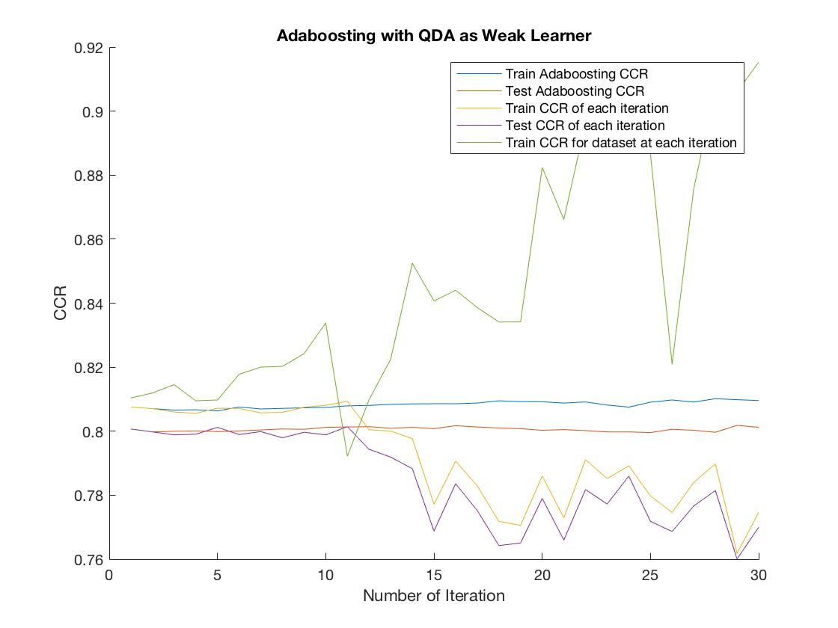
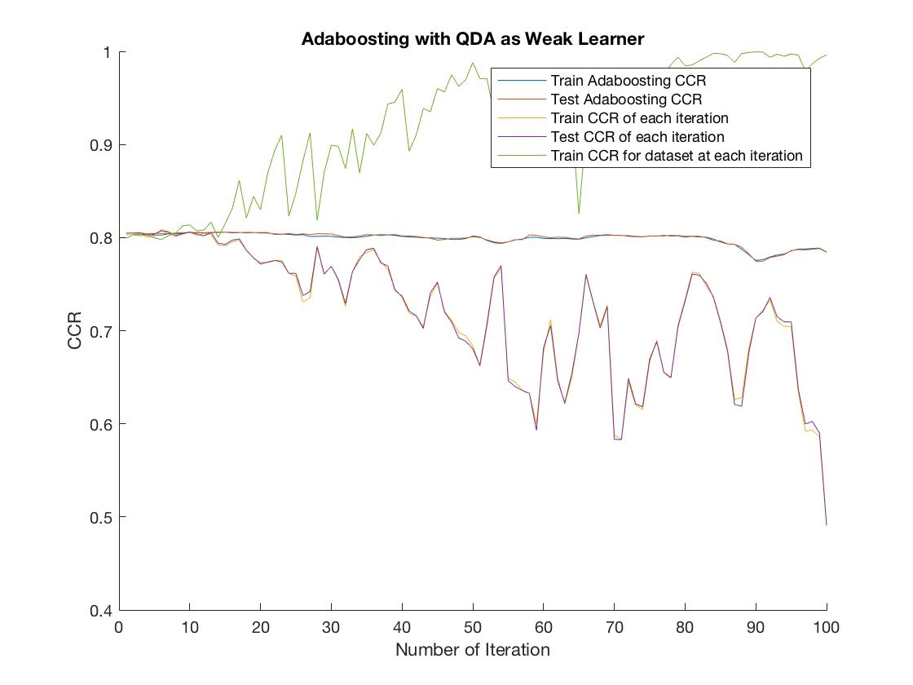
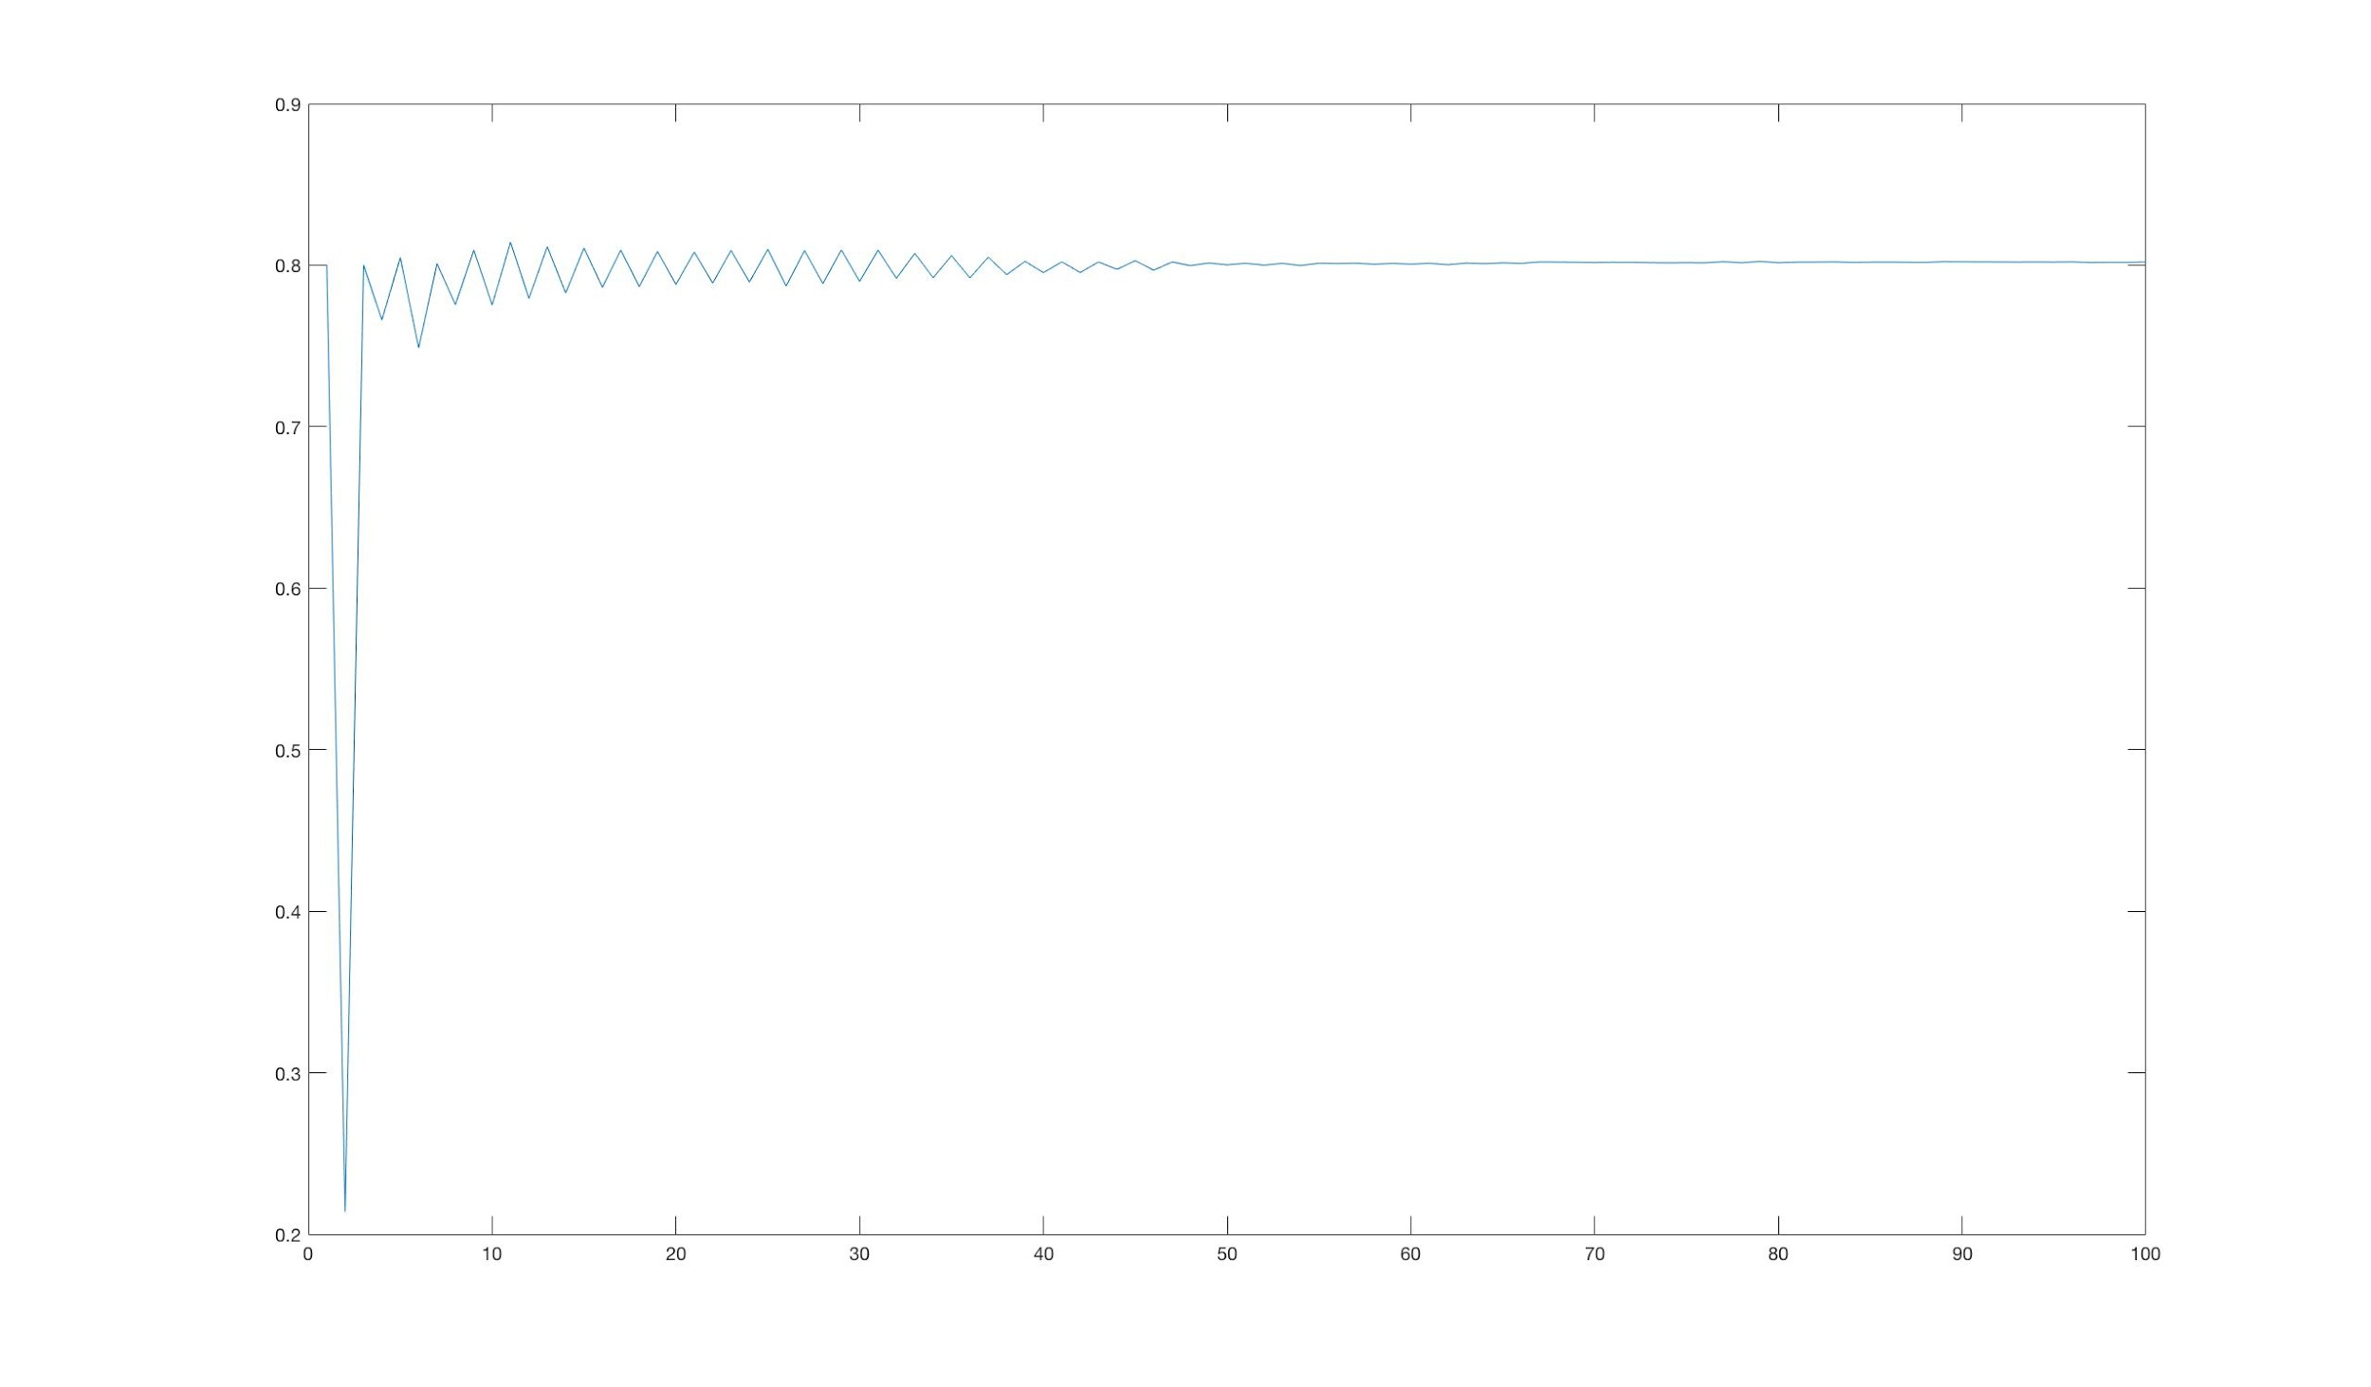
Ensemble Learning
*
Adaboosting with Discriminant Analysis
Adaboosting with Discriminant Analysis
‹#›
Notes:
‹#›

Slide 11
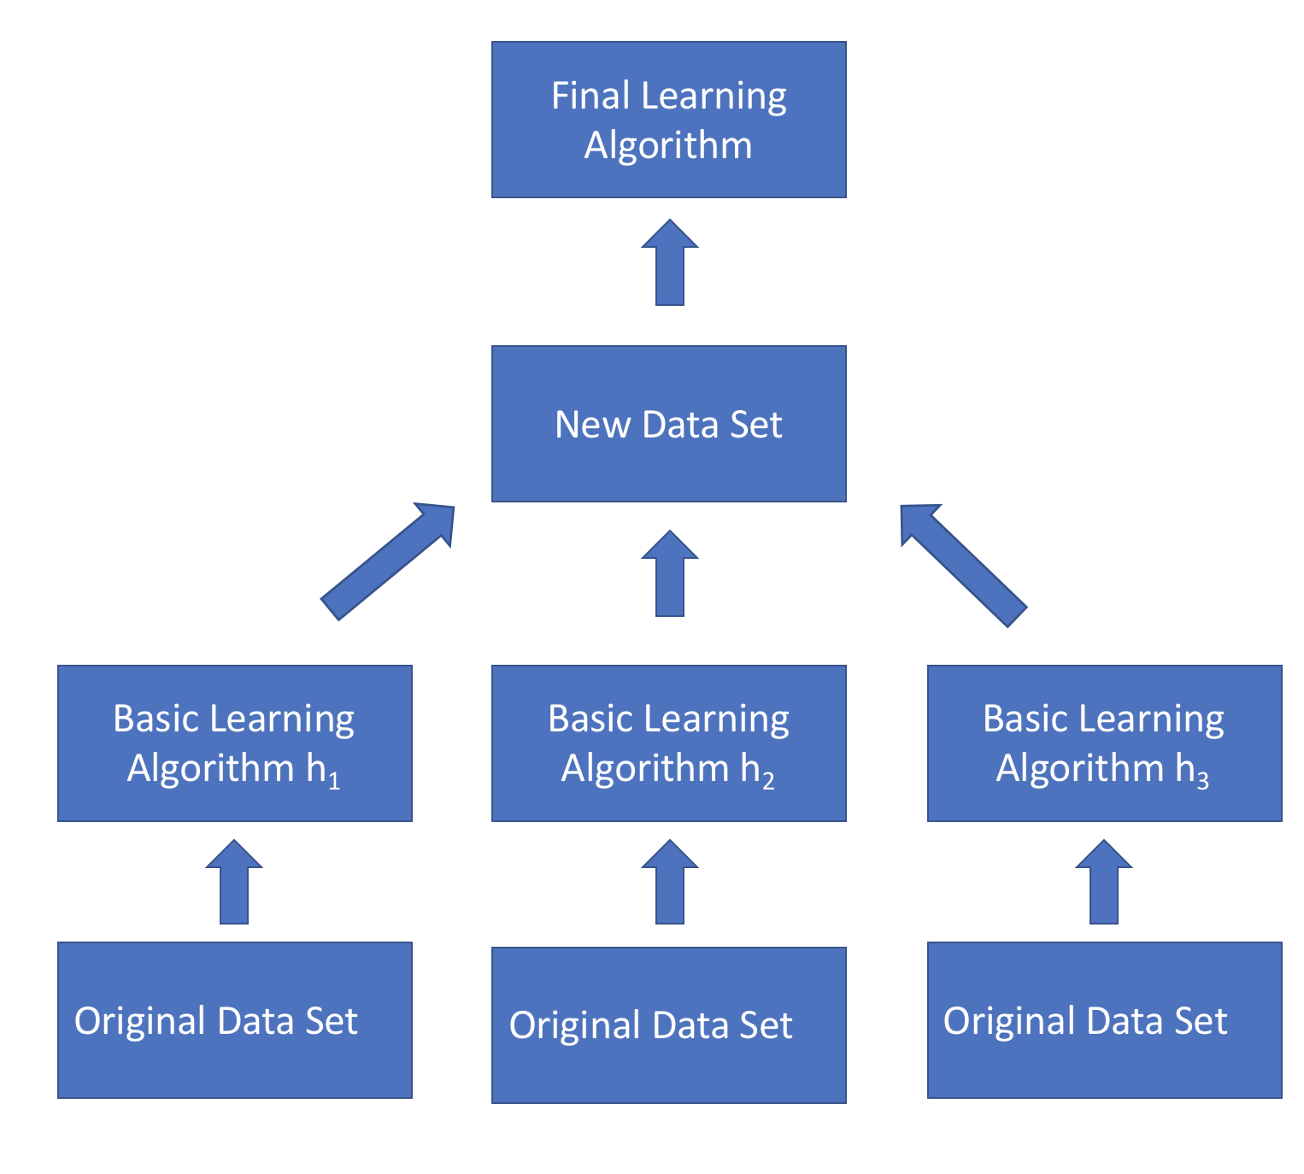
3. Stacking
Ensemble Learning
*
In stacking, multiple classification or regression models are combine to build the final learning algorithm.
.
Second-level learner:
Logistic Regression model is often used as the final combiner
Construct new data set with original data and outputs of each first-level learner
First-level learner:
‹#›
Notes:
‹#›

Slide 12
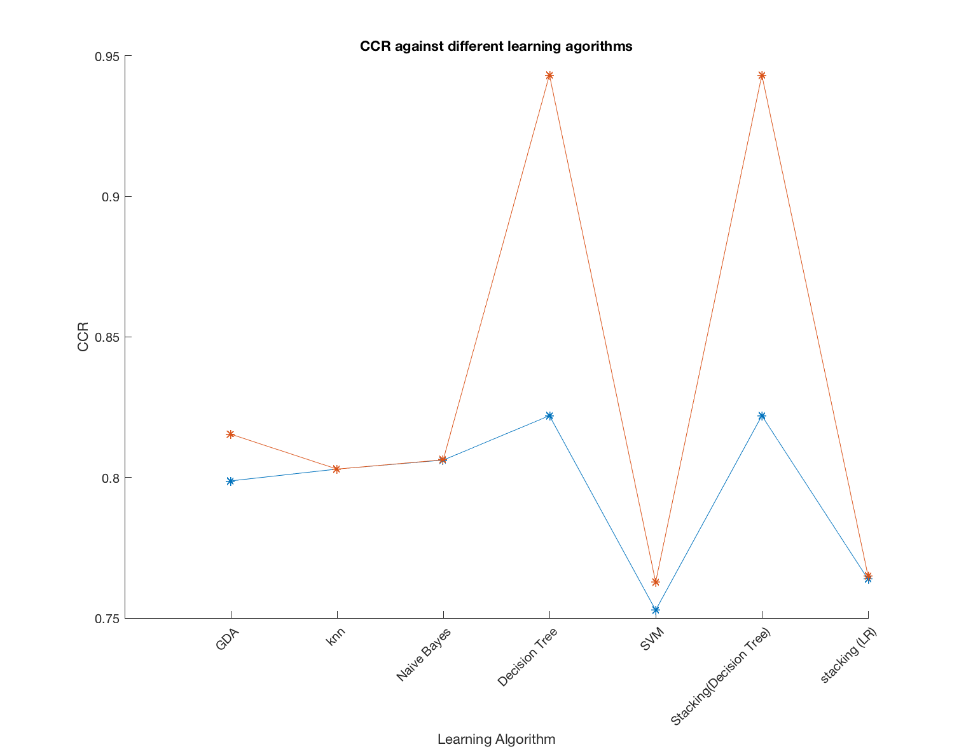
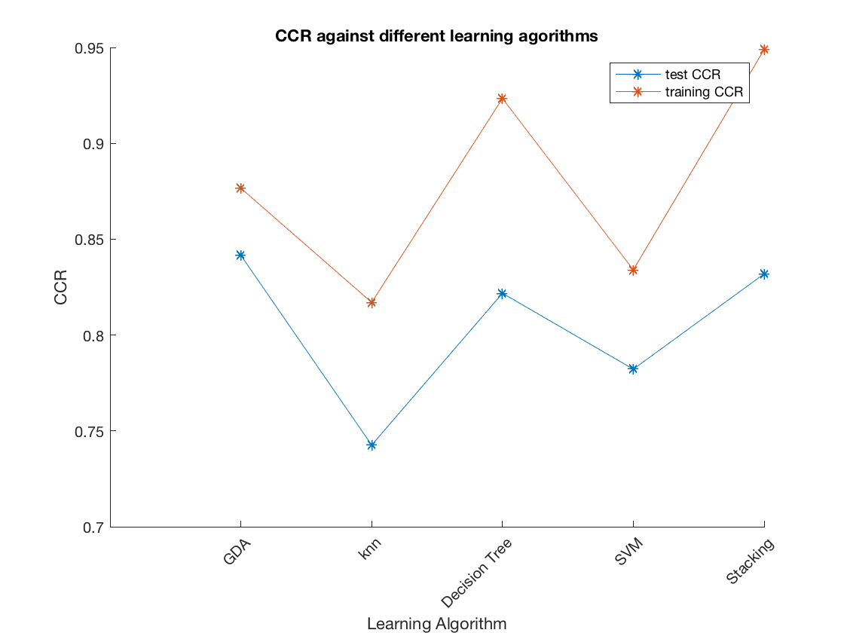
3. Stacking
Ensemble Learning
*
For Adult Dataset (Binary Class)
For Ecoli Dataset (Multiple Class)
‹#›
Notes:
‹#›

Slide 13
Comparing
CCR | Base algorithm | Bagging | Bagging (Built-in) | Ada- boosting | Ada-boosting (Built in) | Stacking
Discriminant Analysis | 78.28% | 79.84% | 79.86% | 80.22% | 79.88% | Decision Tree: 81.5% Logistic Regression: 77.0%
Decision Tree | 78.34% | 85.49% | 85.91% | 80.18% | 85.63%
SVM | 76.90% | 76.38% | Nah | 80.11% | Nah
Ensemble Learning
*
Adult Dataset
Ecoli Dataset
CCR | Base algorithm | Bagging | Bagging (Built-in) | Stacking
Discriminant Analysis | 84.16% | 83.42% | 84.16% | Decision Tree: 83.19%
Decision Tree | 82.18% | 86.13% | 89.11%
SVM | 78.22% | 73.80% | Nah
‹#›
Notes:
‹#›

Slide 14
Conclusion
Ensemble Learning
*
 | Bagging | Boosting | Stacking
Partitioning Dataset | Random | Misclassification samples have higher probability | Did not partition
Goal Achieved | Minimize variance | Increasing predictive force | Both
Combining Classifiers | Average weights | Weights majority vote | Logistic regression / Decision Tree
‹#›
Notes:
‹#›

Slide 15
Future Work
Ensemble Learning
*
Bagging : Keep training sample size fix, increase number of bags-----> How is it affect CCR
Adaboost : Implement multi class algorithm
Stacking : Different ways to combine first level and second level learners
‹#›
Notes:
‹#›

Slide 16
Ensemble Learning
*
Thanks for your listening and any Question?
‹#›
Notes:
‹#›

